Slide 1
IMAGE SCRAPING AND CLASSIFICATION

Slide 2
PROBLEM DEFENITION
Scraping images for the below categories:
Saree
Mens Jeans
Mens Trousers
Develop an image classification Deep Learning network to distinguish between the three

Slide 3
DATA CLEANING AND PREPROCESSING
Data was downloaded using Selenium and beautifulsoup
CNN Deep learning technique was used to classify between the objects
ResNet50 was found to be the best model to the problem

Slide 4
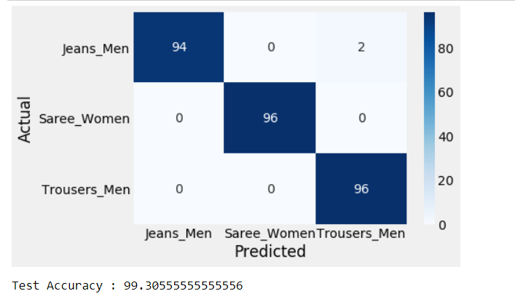
Visualizations
Confusion matrix for the test data set was plotted and the results were astonishing

Slide 5
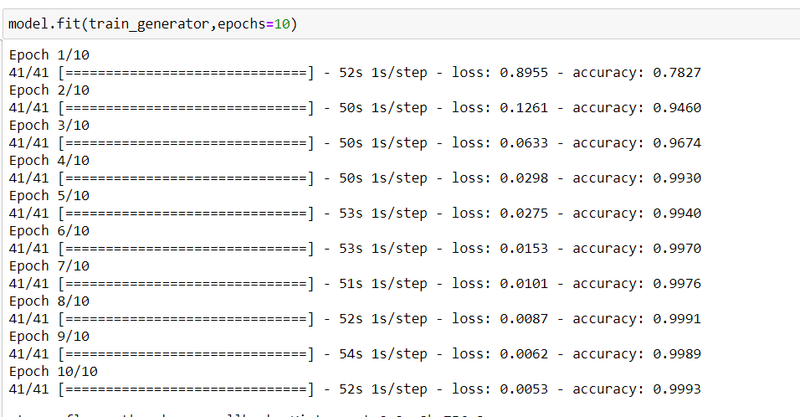
Modelling and Metrics
ResNet50 was considered to be the best model.
Accuracy was chosen as the metric and the loss function was set to binary cross entropy.

